Slide 1
JIT Compilation Attacks in iOS
Nullcon Goa 2023

Slide 2
Who am I?
Obviously, I am Shubham Sharma
Senior Security Engineer at we45
Performs VAPT on web, API, mobile apps
Course creator at AppSec Engineer related to various vulnerabilities, Cloud and AD securities
Writes blogs on trendy security vulnerabilities

Slide 3
Agenda
iOS architecture and security mechanism
Basics of JIT Compilation
JIT Compilation Attacks and exploitation techniques
Case studies and CVEs
Mitigation techniques and counter-measures
Conclusion and QnA

Slide 4
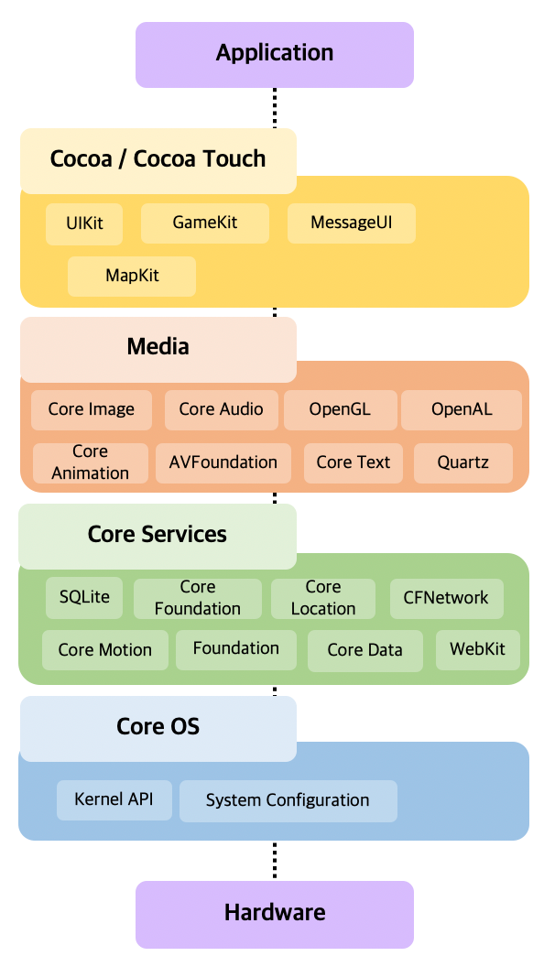
iOS Architecture
It has 4 layers
Cocoa Touch
Media
Core Services
Core OS

Slide 5
Need to understand iOS architecture
Optimal Performance
Security and Privacy
User Experience (UX)
Resource Management

Slide 6
Aot vs JIT Compilation
Ahead of Time
Just in Time
Compiles high-level code to machine code before execution.
Faster startup since the code is pre-compiled and less memory usage since there's no need for an on-device compiler.
Less prone to runtime attacks since the code doesn't change after compilation.
Compiles high-level code to machine code during execution.
Slower startup due to on-the-fly compilation and higher memory usage as the compiler and source code might be needed in memory.
More susceptible to runtime attacks, such as code injection, since code is being compiled and executed dynamically.

Slide 7
Aot vs JIT Compilation
Ahead of Time
Just in Time
Apple's iOS doesn't allow JIT compilation for third-party apps due to security concerns. Therefore, AoT is the main method used in iOS development.
Not allowed for third-party app development on iOS. However, Apple uses JIT for its own processes, like the JavaScript engine in Safari.
Apple allowed JIT Compilation starting from iOS 14.2, only at dev build, so sideloaded apps could be JIT compiled.

Slide 8
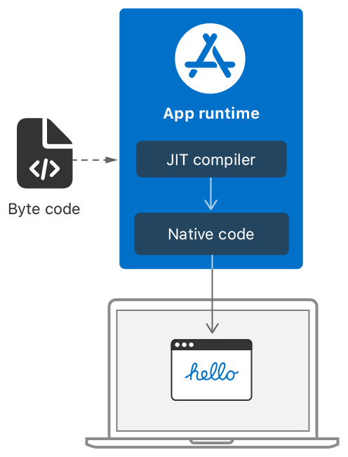
Basics of JIT Compilation
JIT (Just-In-Time) Compilation is the process of turning bytecode or source code into native machine code just before it's executed.
Advantage of JIT compilation is speed, as it can optimize the code at runtime, adapting to the specific environment it's running in.

Slide 9
Why iOS Uses JIT
Given the resource constraints of mobile devices, JIT allows efficient use of available system resources.
JIT can make certain processes, especially JavaScript execution in web browsers, run much faster than interpreting the code.

Slide 10
Understanding Jit compilation in the context of Safari JavaScript engine
Safari browser on iOS devices uses the JavaScriptCore (JSC) engine to handle the execution of JavaScript code.
JSC interprets and executes JavaScript code on web pages.
Safari initially relied heavily on interpreted JavaScript, which was straightforward but not the most efficient in terms of speed.
As web applications grew in complexity, the need for speed and efficiency became paramount.

Slide 11
JIT Compilation Attack
The JIT (Just-In-Time) compilation involves converting bytecode into native machine code at runtime.
There are few of many attack scenarios:
JIT Spraying
Bypassing ASLR
Type Confusion
Deoptimization Attacks

Slide 12
JIT Spraying
JIT spraying involves feeding crafted input to a JIT compiler, causing it to generate malicious machine code that resides in executable memory regions.
iOS devices, especially through the Safari browser, rely on JIT compilation for efficient JavaScript execution.
With precise input, an attacker might induce the JIT compiler in Safari to generate and execute malicious payloads.

Slide 13
Bypassing ASLR
Address Space Layout Randomization (ASLR) randomizes memory locations to make it challenging for attackers to predict the address of specific functions or buffers. However, with JIT vulnerabilities, attackers might be able to leak memory addresses.
iOS employs ASLR as one of its core security mechanisms.
Exploiting weaknesses in JIT could reveal memory layouts in Safari or other JIT-reliant apps, undermining ASLR's effectiveness

Slide 14
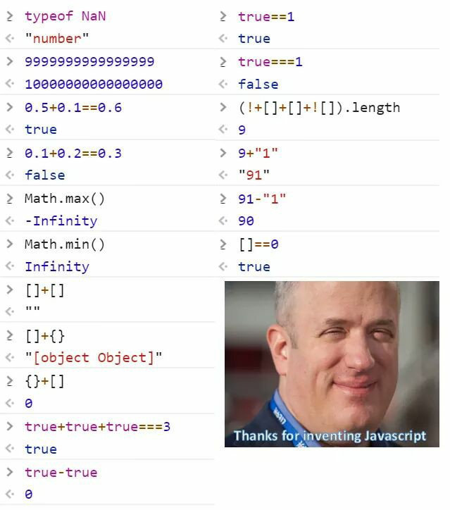

Slide 15
TYPE Confusion
Type confusion arises when the system misinterprets data of one type as another, potentially leading to unintended behaviors or vulnerabilities.
Safari's JavaScript engine relies on type inference for optimization. Incorrect type assumptions can be exploited to cause arbitrary memory reads/writes.
Such vulnerabilities can provide a foothold to attackers, enabling them to escalate privileges or execute arbitrary code.

Slide 16
Deoptimization Attacks
Safari's JavaScript engine, uses JIT compilation that relies on various optimization techniques.
Crafted payload can cause aggressive optimization followed by deoptimization; attackers can potentially destabilize the system.
When the system handles these deoptimizations improperly, it results in exploitable conditions, like out-of-bounds memory access or use-after-free scenarios.

Slide 17
Previously reported cves
CVE-2020-27930
CVE-2020-980x
CVE-2020-3862
CVE-2019-8605
CVE-2018-4192

Slide 18
CVE-2020-27930
Safari is susceptible to a remote code execution vulnerability via an undefined character in Type 1 fonts handled by libType1Scaler.dylib on macOS and iOS.
Issue was fixed in iOS 14.2 security fix and iOS 12.4.9 update
https://packetstormsecurity.com/files/161294/Apple-Safari-Remote-Code-Execution.html

Slide 19
CVE-2020-9802, 9803, 9805, 9806, 9807
A memory corruption and logic issue was addressed with improved state management and restriction.
These vulnerabilities were part of Google’s Project Zero.
These were fixed with iOS 13.5 and Safari 13.1.1

Slide 20
Why is it so important?
Ubiquity of iOS Devices
Sensitive Data Storage
Trust in the Apple Ecosystem
Complexity of Modern Web Browsing
Evolution of Attack techniques
Securing Future Implementations

Slide 21
Impact of JIT Compilation Attack
Unauthorized Code Execution
Data Leakage
Bypassing Security Mechanisms
Performance Degradation
Reputational Damage

Slide 22
Mitigation Technique
Enhanced Code Auditing
Restricted JIT Execution
Sanitization and Validation

Slide 23
Future topic of research
Advanced Detection Mechanisms:
Develop techniques or tools to automatically detect when a JIT process is being exploited, potentially in real-time.
Deep Dive into JIT Internals:
As JIT compilers become more complex, understanding their deep internal workings can reveal unforeseen vulnerabilities or avenues of attack.
Holistic System Analysis:
Instead of focusing solely on JIT, look at how JIT interacts with other system components. This holistic view might uncover vulnerabilities that arise from these interactions rather than JIT itself.
Alternative Compilation Techniques:
Research into alternatives to JIT, or hybrid approaches, that might offer the performance benefits of JIT without the associated security risks. Use advanced fuzzing techniques targeted specifically at JIT processes to discover new vulnerabilities.

Slide 24
Q&A

Slide 25
Thank You!!
Now, let’s go and fill out our empty stomach with lunch outside 😉

