Slide 1
Your app is probably a spyware ………or is it?

Slide 2
$whoami
Pandurang Patil, Chief Architect
Gaurav Gogia, Security Research Engineer

Slide 3
Some food for thought
Do we really trust the code in our apps?
What about all the libraries?
Third party SDKs?
Analytics/Advertising APIs?

Slide 4
Keep last few questions in mind

Slide 5
Agenda
Why do we have data leaks?
Privacy erosion in modern apps
Privacy aware SDLC
SAST for Privacy
Demo

Slide 6
Why do we have data leaks?
Hardcoded Credentials
Poisoned Well – Malicious Libraries
Invasive Third-Party SDKs
Ignoring User Consent

Slide 7
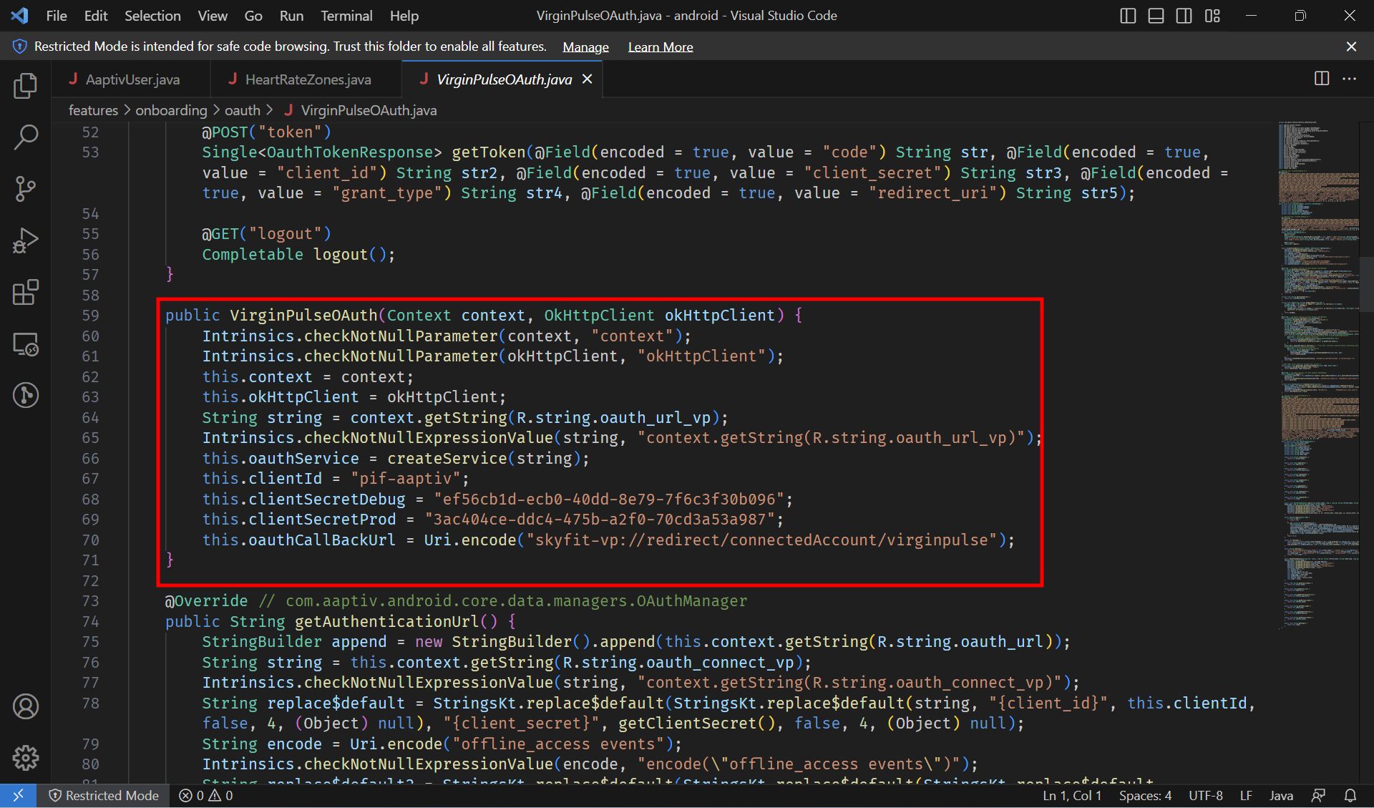
Hard Coded Credentials

Slide 8
Poisoned well – Malicious Libraries
requests2 (proxy of requests) package
prerequests-xcode RAT package in NPM

Slide 9
Invasive Third-Party SDKs
Mobile App
Third-Party SDK
Analytic/PII/PHI Data Collection
POST Call to Third-Party SDK API
If SDK has not been vetted, it is a privacy risk

Slide 10
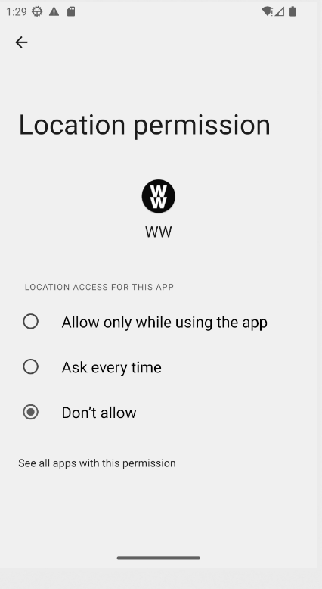
Ignoring User Consent

Slide 11
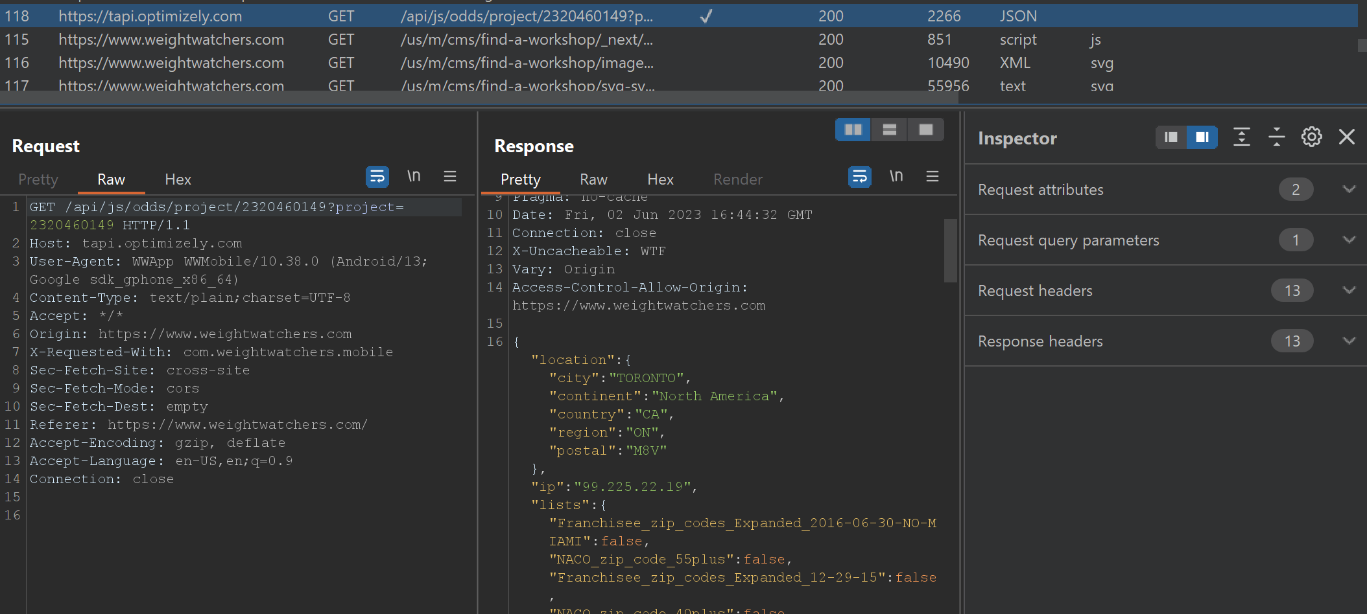
Ignoring User Consent

Slide 12
Control is the name of the game
Code
No Data
Websites/Mobile Apps
Less Data
Analytics Services
More Data
Third Parties
Even More Data
Databases/Data-lakes
Big Data

Slide 13
Privacy Erosion in Modern Apps
PII
Social Security Numbers
Credit Card Information
Social-media Footprint
PHI
Physical/Mental Health Identifiers
Running/Yoga/Workout Routine
Medicine Prescription

Slide 14
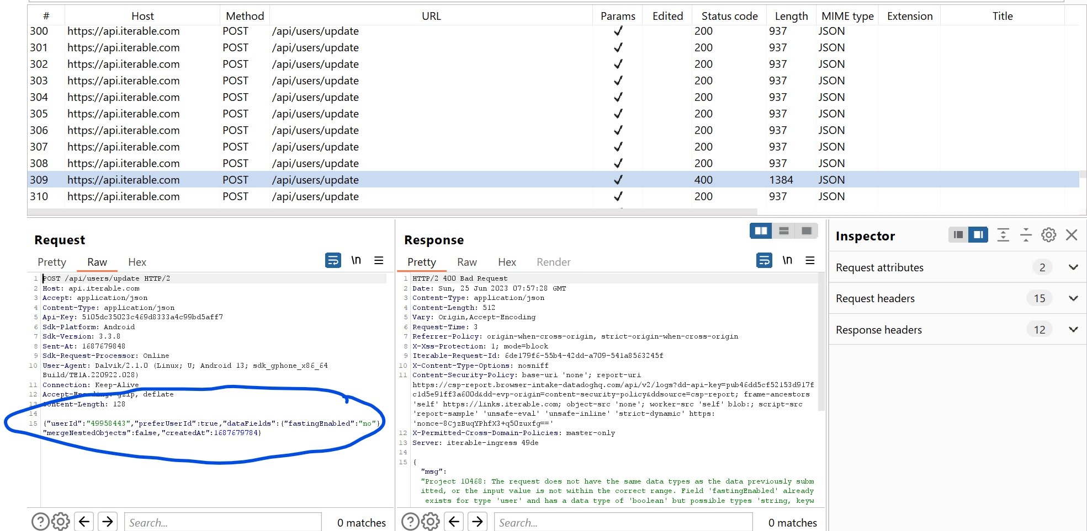
Impact on Users – PII/PHI Data Leak

Slide 15
Only YOU can stop forest fires
Why would a Water Drink Reminder app need location access?
Why would Sleep tracking apps record sounds all night?
Why is there a need to collect Blood Sugar data for a food delivery app?

Slide 16
Privacy aware SDLC
Privacy as a fundamental design principal
Shifting privacy left

Slide 17
Developing a Privacy aware SDLC
Actively audit third party libraries/SDKs/APIs
Run Static Code Analysis tools on builds
Inject Static Code Analysis tools in CI/CD

Slide 18
Isn’t Static Code Analysis just regex?
public class User { latitude float; longitude float; username String; email String; }
void fun1() { User ukalyptus = new User(); send(ukalyptus); } void send(temp User) { someApiCall(temp); }

Slide 19
Isn’t Static Code Analysis just regex?
Languages are logical constructs
Regex loses context
Object data flows are important
Object data types and names can mutate

Slide 20
Isn’t Static Code Analysis just regex?

Slide 21
What is Static Code Analysis?
Code Analysis done while Code is not being executed.
Involves parsing source code and generate CST (Concrete Syntax Tree/ AST (Abstract Syntax Tree )
Processing this CST / AST and create Graph data structure, which can be queried for the information.

Slide 22
Few Static Code Analysis Tools
CodeQL
Privado CLI
semgrep

Slide 23
How Static Code Analysis is used for Privacy ?
Graph data structure created by processing CST/AST need to be updated with extra edges like Control Flow Graph, Data Dependency Graph
These extra edges will facilitate get data flows from one place of code to other.
Which in-turn facilitate identify if specific data is being passed to any third party services and at which place in the code

Slide 24
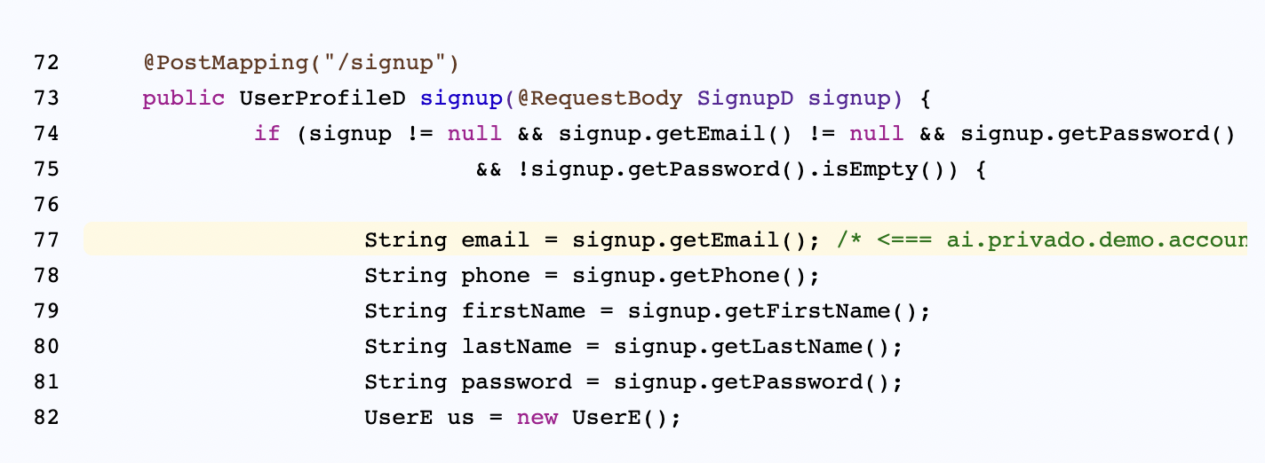
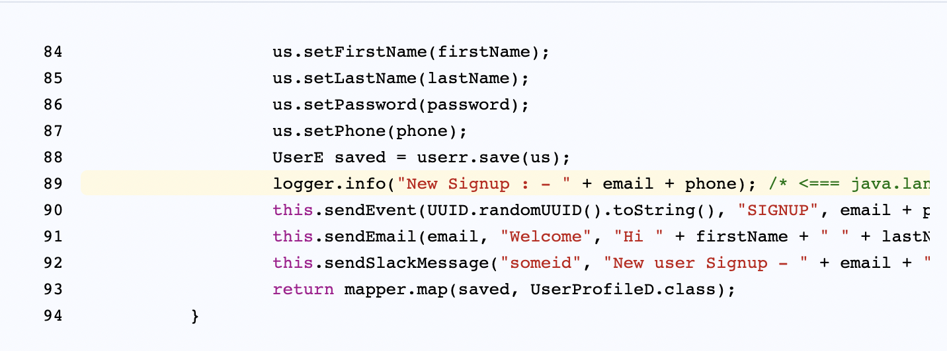

Slide 25
How do WE shift Privacy LEFT
CODE PROPERTY GRAPHS
DATA FLOWS

Slide 26
Finding Data Flows
Parse
Generate
Prepare
Find
Application Code
Abstract Syntax Tree
Code Property Graph
Flows from Sources to Sinks

Slide 27
Demo Time

Slide 28
Q/A

Slide 29
Let’s Connect

